Slide 1
HTML Elements

Slide 2
HTML Heading Elements
We have six different types of headings from h1 to h6
Syntax
<h1> This is main and biggest heading</h1>
<h2> This is main and biggest heading</h2>

Slide 3
HTML Paragraph Element
The <p> HTML element represents a paragraph.
Syntax
<p> This is a paragraph text </p>

Slide 4
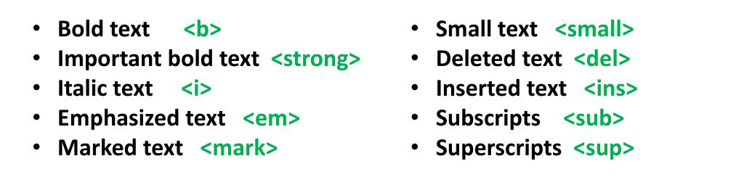
HTML Formatting Elements
HTML Formatting is a process of formatting text for better look and feel. HTML provides us ability to format text without using CSS. There are many formatting tags in HTML. These tags are used to make text bold, italicized, or underlined.
Some examples

Slide 5
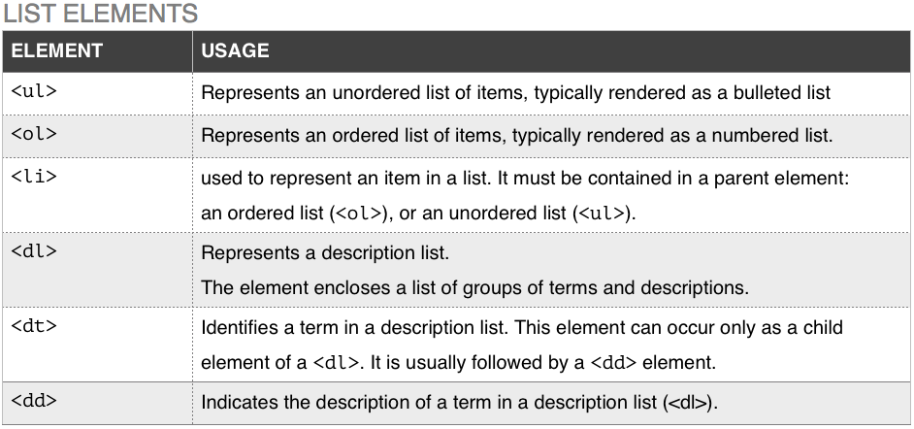
HTML List Elements
Some examples

Slide 6
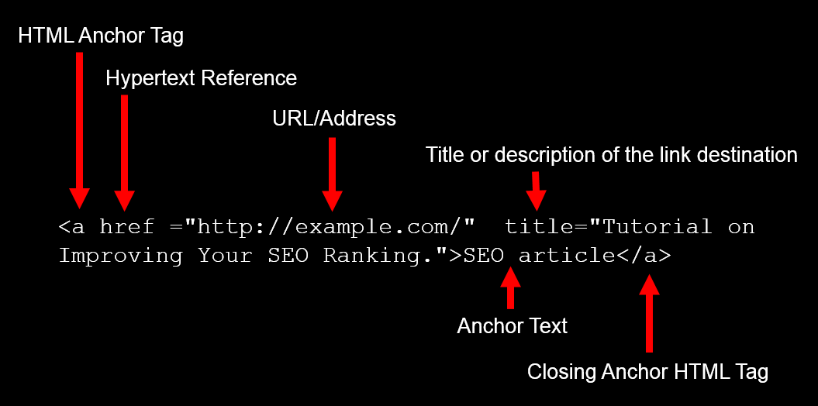
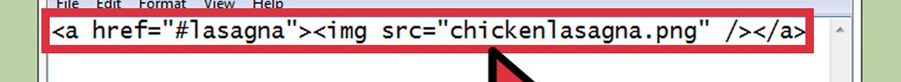
HTML Hyper link Elements
Some examples
You can embed link in the image

Slide 7
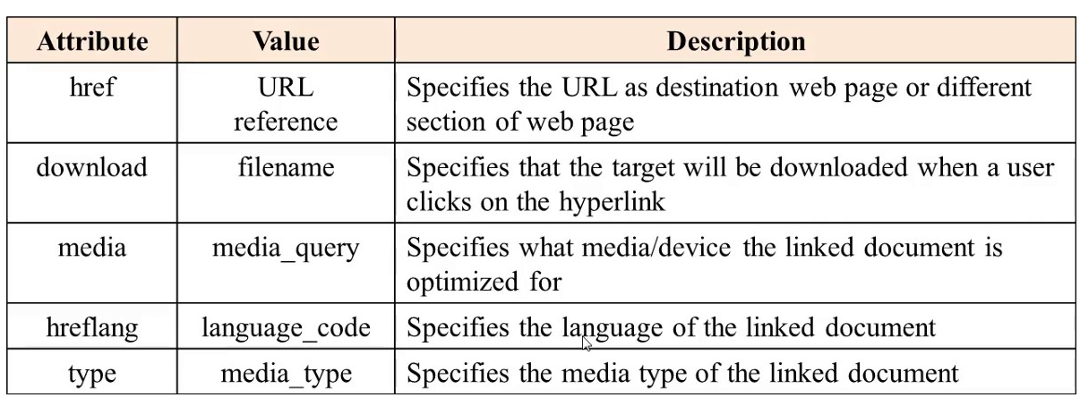
HTML Hyper link Elements
Anchor tag Attributes

Slide 8
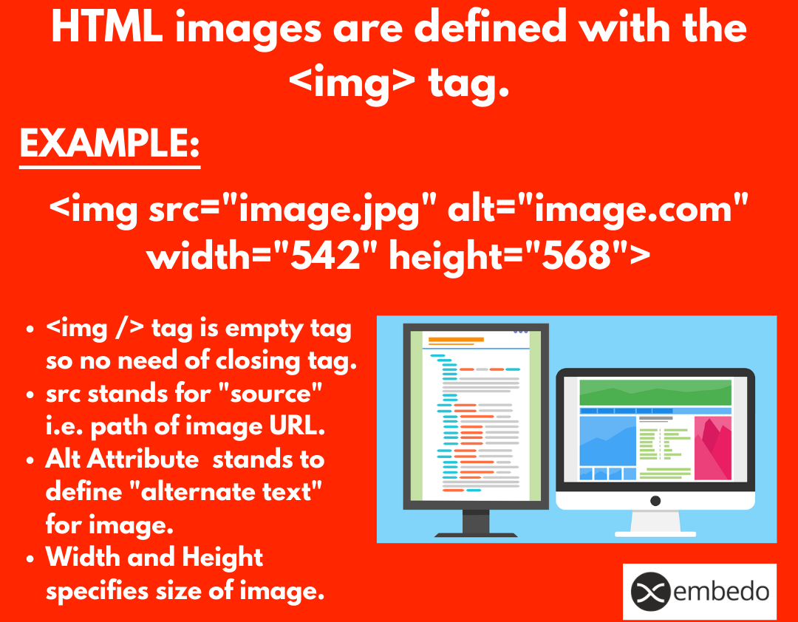
HTML Images
Anchor tag Attributes

Slide 9
HTML Images
Lesson2 folder
Index.html
images
computer.jpg

Slide 10
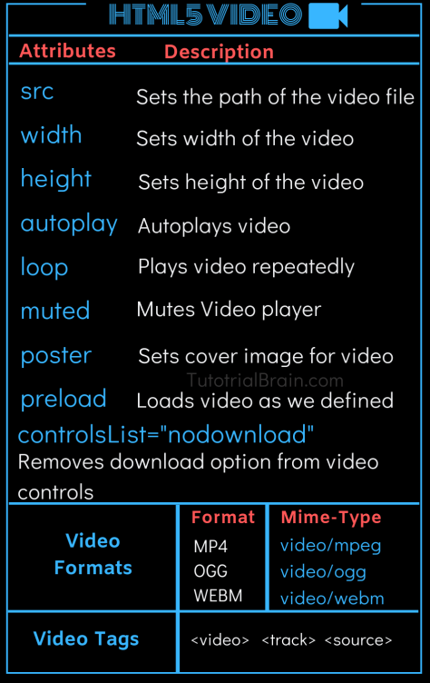
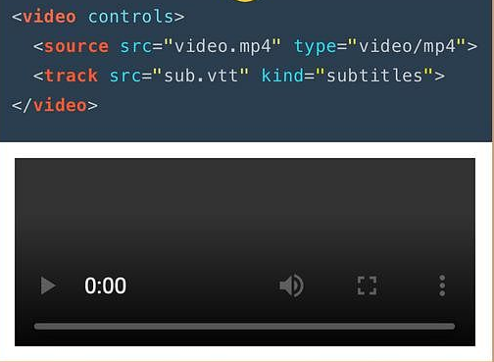
HTML Videos
Syntax and Output

Slide 11
Github
Purpose
Sharing code between teams
Tracking changes ,
Requirements
Signup for an account on github.com
Download gitdesktop

